Slide 1
Welcome To The
Summer 2015
Web Development
Bootcamp

Slide 2

Notes:
Fedora
Fedora is changing education by making it easy to teach or sell courses online. Teacher entrepreneurs use Fedora to run their own courses work with almost half a million students online.
In a matter of minutes, Fedora allows you to create a beautiful and powerful, payment-ready course from your own website without any technical knowledge. While many use Fedora for asynchronous video-based classes teachers have used it to sell books, services, offline-online classes, group coaching, tutoring and webinars.

Slide 3
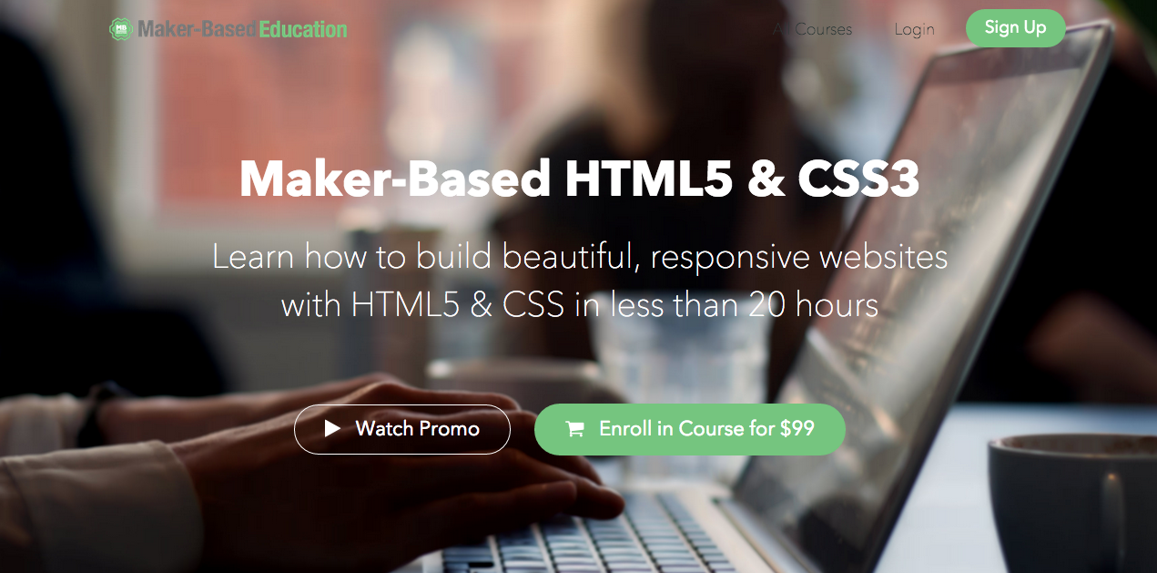
Notes:
Maker-Based Education
We’re working to make it as easy and fast as possible for anyone to learn front-end web development skills by focusing on project-based learning. In 2014 we had one of the top 3 largest for-pay online HTML/CSS courses with a 5-star rating.

Slide 4

Notes:
Fedora
Fedora is changing education by making it easy to teach or sell courses online. Teacher / entrepreneurs use Fedora to run their own courses work with almost half a million students online. We are currently the fastest growing online learning management platform.

Slide 5

Notes:
How To Land A Job You Love
This is the course I wish I had when I was in school. I worked with best-selling author Charlie Hoehn on this to create an exact step-by-step method that’s helped thousands of his readers create amazing careers for themselves. We’ve followed this exact blueprint to get jobs with non-profits, fast growing startups, and big time entrepreneurs and authors like Ramit Sethi, Tim Ferriss, and Seth Godin.

Slide 6
Coding and Technology: Why Learn It,
Why Teach It

Slide 7
You may have seen the recent stats...

Slide 8
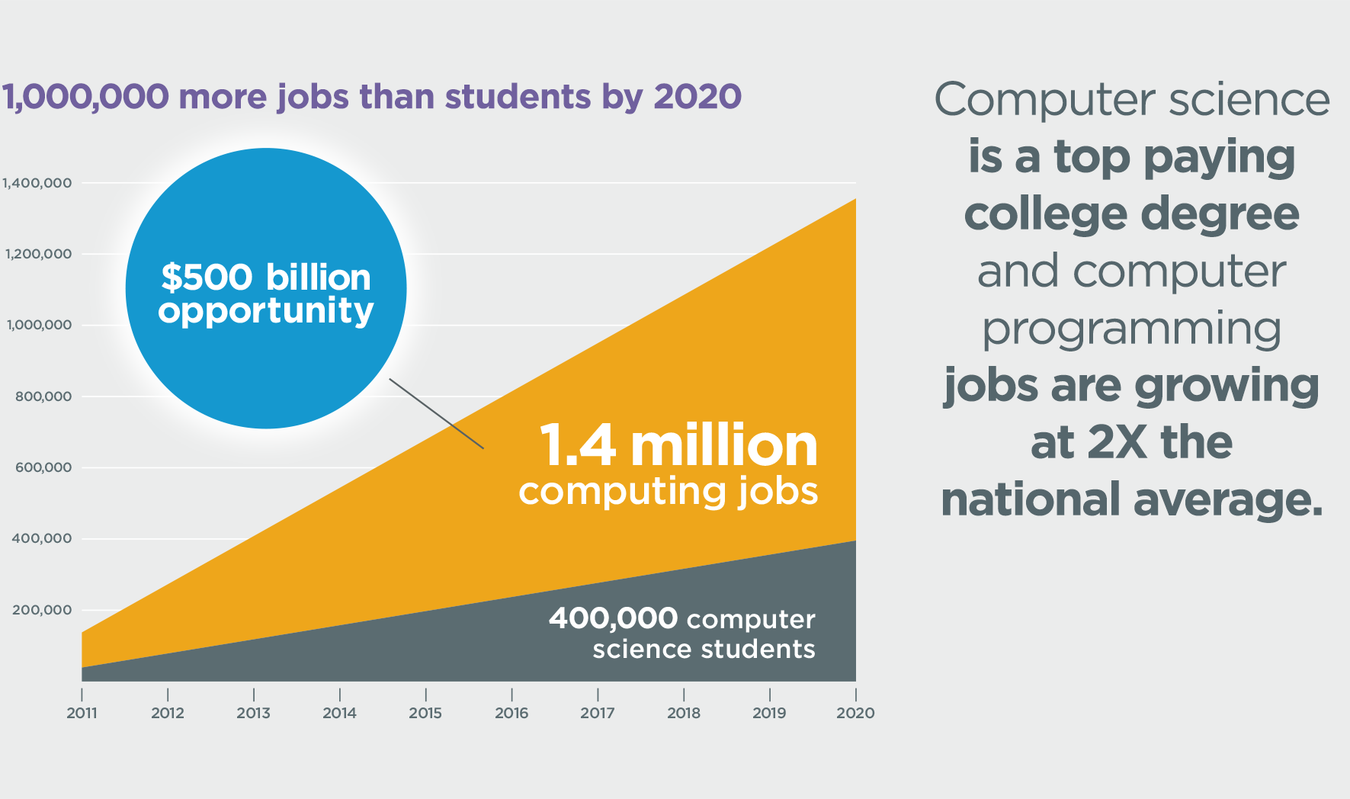

Slide 9
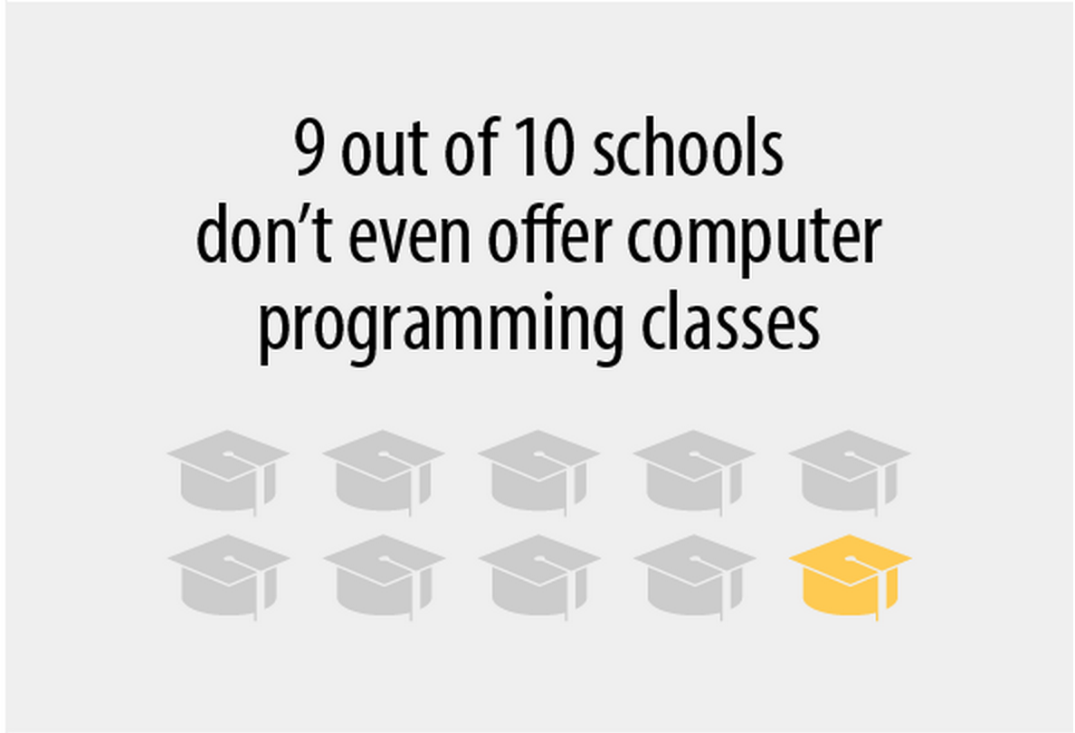

Slide 10
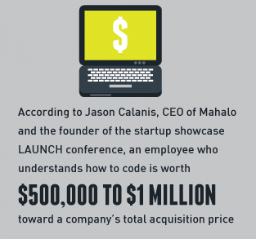

Slide 11
But what about the global trends?

Slide 12
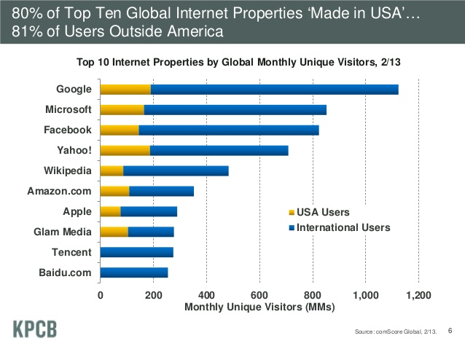

Slide 13
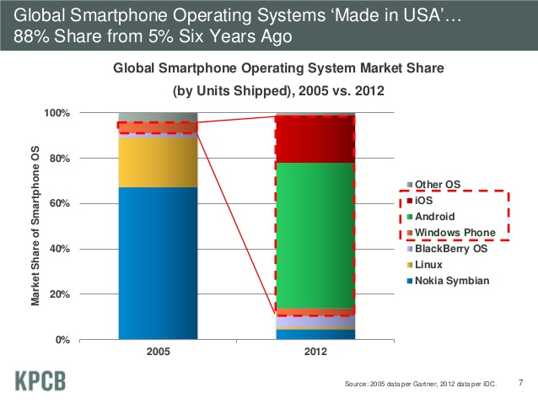

Slide 14
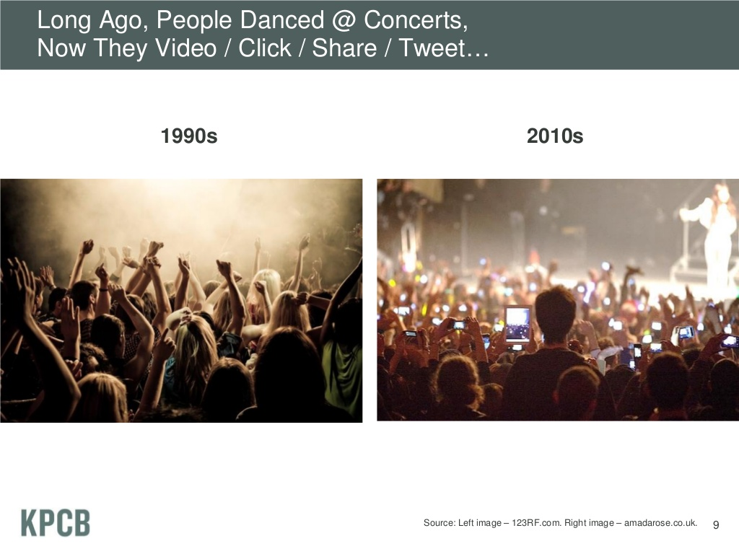

Slide 15
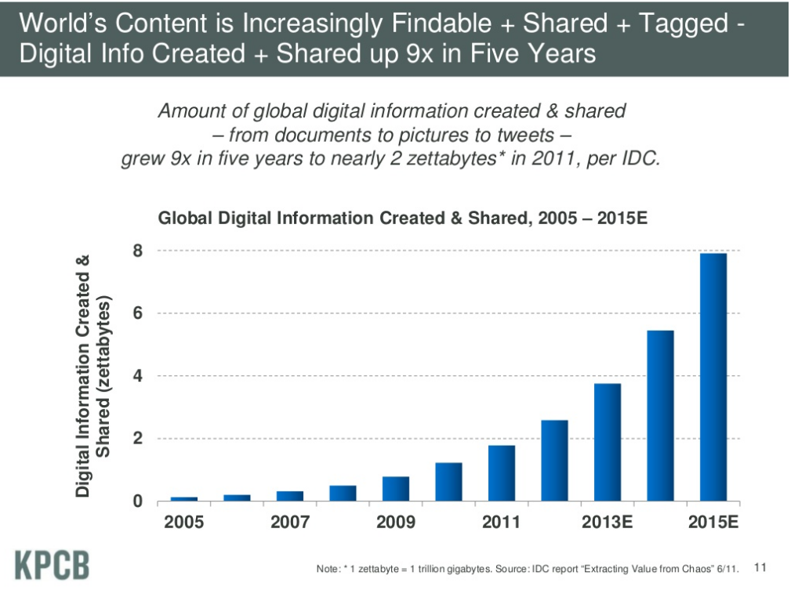

Slide 16
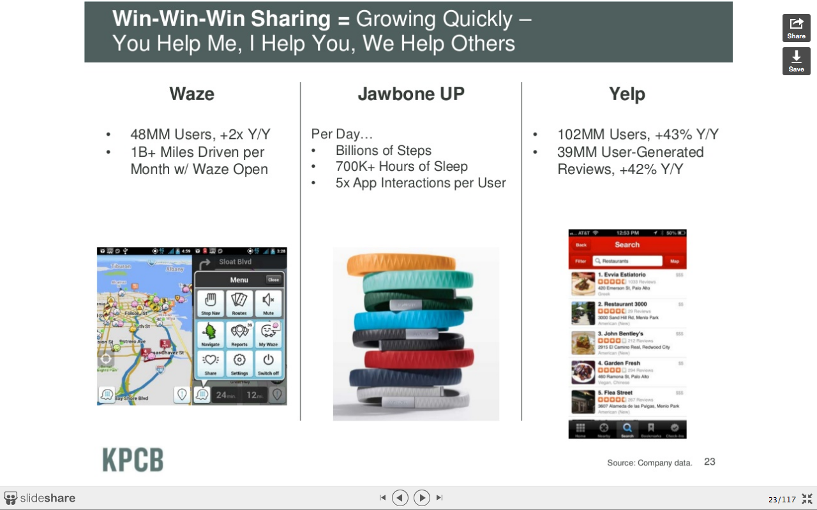

Slide 17
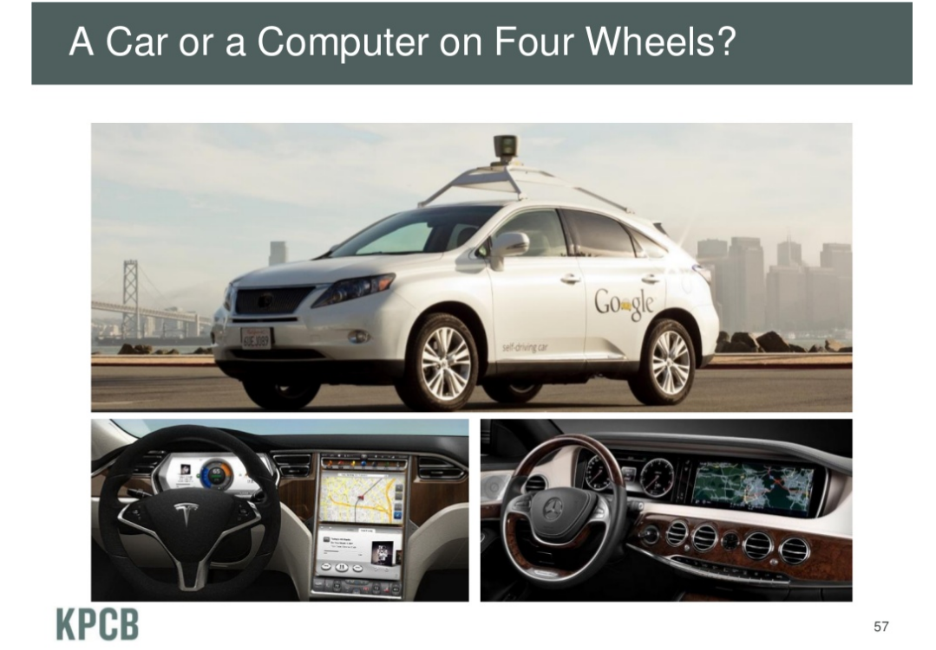

Slide 18
What does all of it mean?

Slide 19
What do you like to do?

Slide 20
What about the kids that don’t want to go into computer science?

Slide 21
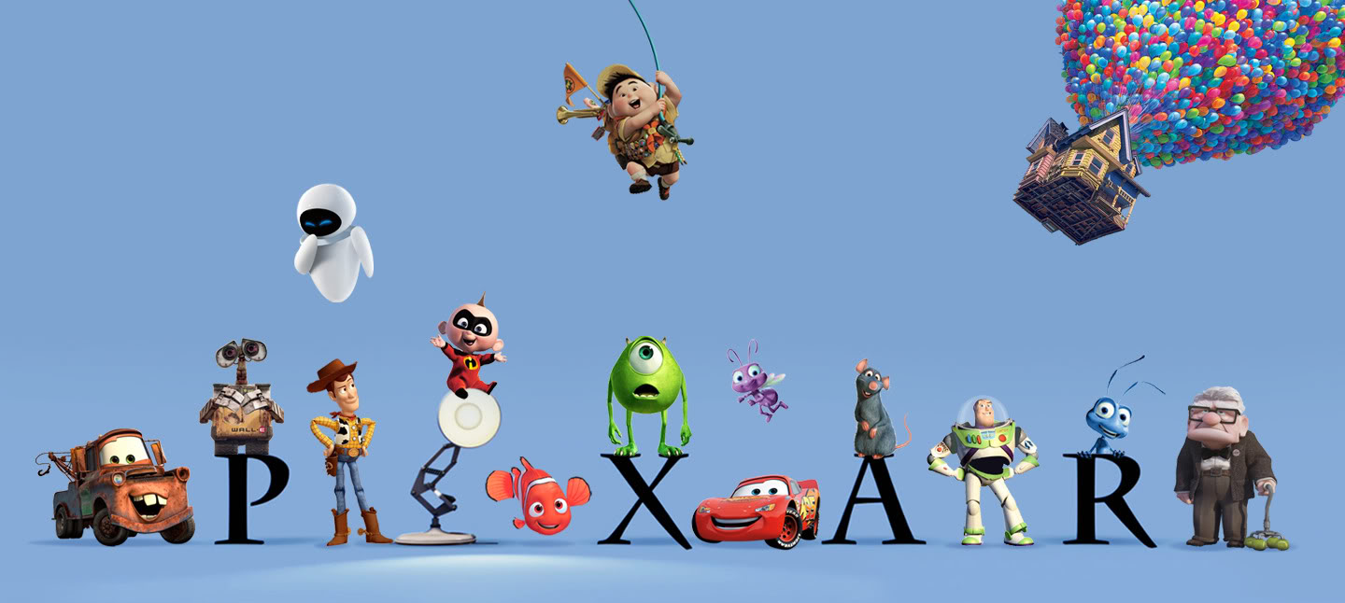
Maybe art?
Notes:
ten weeks. ed catmull

Slide 22

Or music?

Slide 23
Or maybe marketing or psychology?

Slide 24
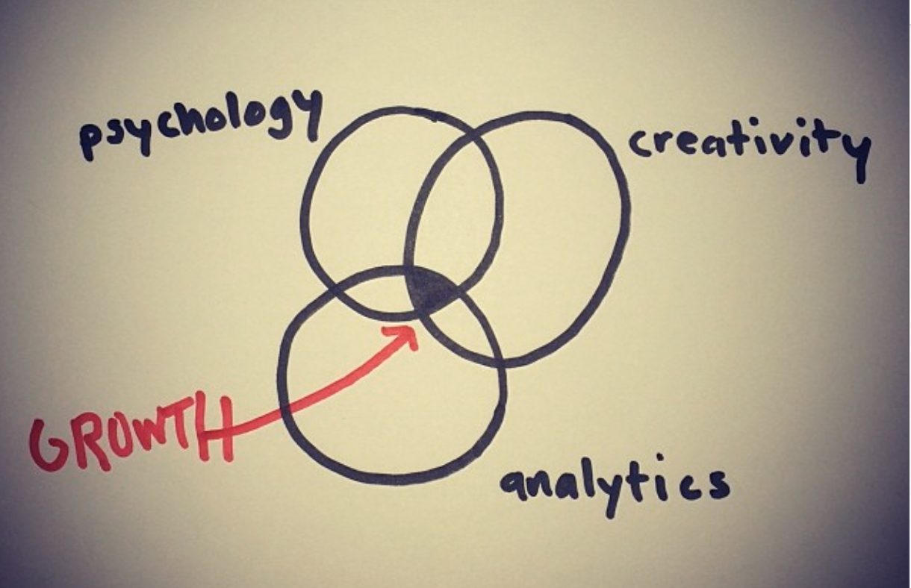
New jobs are popping up at the crossroads of

Slide 25
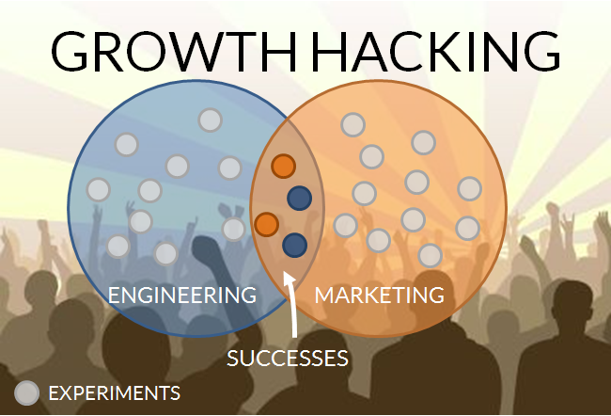

Slide 26

Technology is present to add value and opportunities.
Breanden Beneschott

Slide 27
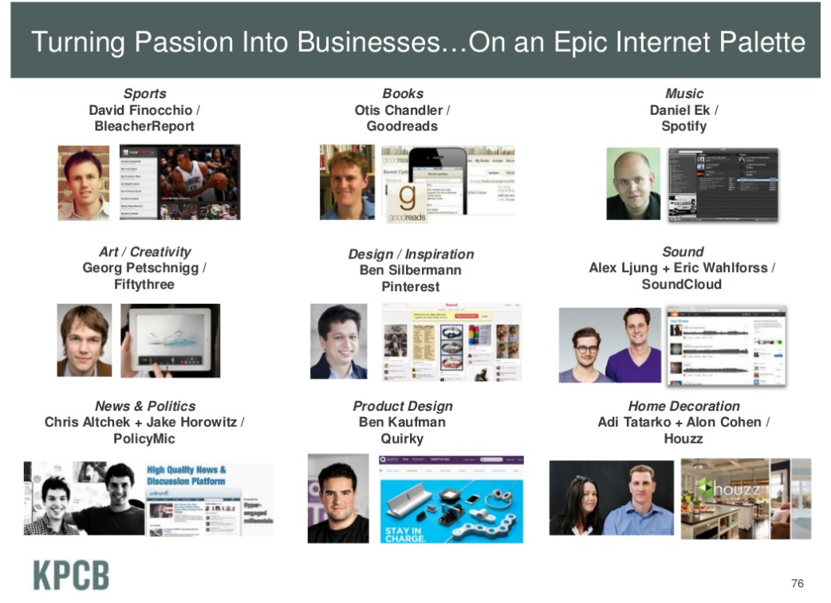

Slide 28

Read. Write. Code
I see coding (computer programming) as an extension of writing. The ability to code allows you to “write” new types of things – interactive stories, games, animations, and simulations. And, as with traditional writing, there are powerful reasons for everyone to learn to code.

Slide 29

There are 2 types of people:
creators
1
the 1% that creates
Notes:
creators know how to code and create the technology and the world around us we interact with daily
consumers don’t. Their lives are dependent on and their interactions are shaped by the technologies being built.

Slide 30
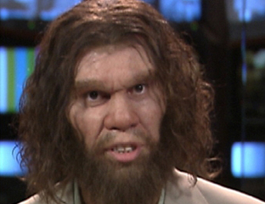
There are 2 types of people:
consumers
2
the 99% that simply consume it
Notes:
creators know how to code and create the technology and the world around us we interact with daily
consumers don’t. Their lives are dependent on and their interactions are shaped by the technologies being built.

Slide 31
creators
1
consumers
2
Know how to code. They create the technology and shape the world we interact with daily.
Don’t know how to code. Their lives are dependent on and their interactions are shaped by the technologies being built.
Notes:
creators know how to code and create the technology and the world around us we interact with daily
consumers don’t. Their lives are dependent on and their interactions are shaped by the technologies being built.

Slide 32
we want you to be
CREATORS

Slide 33
Positive benefits beyond the job

Slide 34


Slide 35
But what about students that can’t learn coding?

Slide 36
I truly believe that not being able to code is about as probable as someone not being able to write. It’s because they are taught ineffectively and/or they are not used to it. Like immersing kids in a foreign language at a young age.

Slide 37
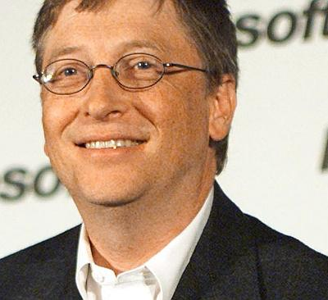


Slide 38

In the process of learning to code, people learn many other things. They are not just learning to code, they are coding to learn. In addition to learning mathematical and computational ideas (such as variables and conditionals), they are also learning strategies for solving problems, designing projects, and communicating ideas. These skills are useful not just for computer scientists but for everyone, regardless of age, background, interests, or occupation. - Mitchel Resnick
Notes:
they’re getting kids in this mindset with teaching them coding and exploration at a young age

Slide 39

The big benefit is the mindset

Slide 40
What happens when you have this mindset?

Slide 41

2 Hacks

Slide 42


Slide 43
It wasn’t coding that got them there.

Slide 44
And what do they look like as students?

Slide 45

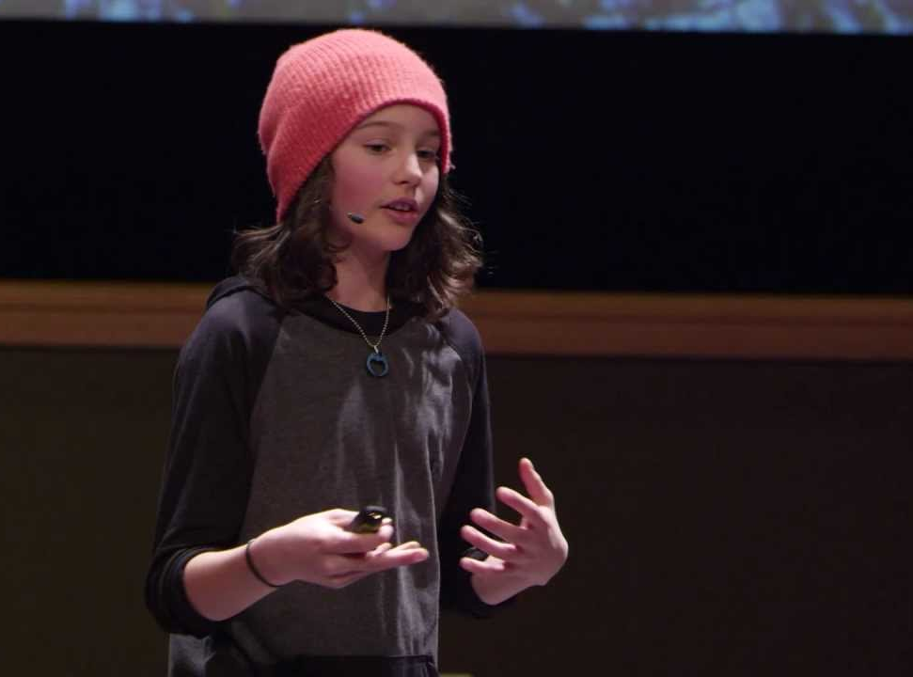
Thomas Suarez
Logan LaPlante

Slide 46
The Takeaway?
Happiness, Problem-Solving and Freedom

Slide 47
Goals For This Week
1
Know the 20%
2
Build… a lot
3
Portfolio
4
Fun and learning from each other

Slide 48
Suggestions
1
Practice in short bursts and make a schedule
2
Go through one time and write in the code
3
Once you’ve completed a presentation it’s your turn to go in and build something on your own
4
Quantity over quality
5
REPETITION, repetition, REPETITION
5
Encourage exploration - lack of hand out resources

Slide 49
Show Of Hands...
1. Teachers
2. Future Teachers
3. Who completed the suggested material?

